Slide 1
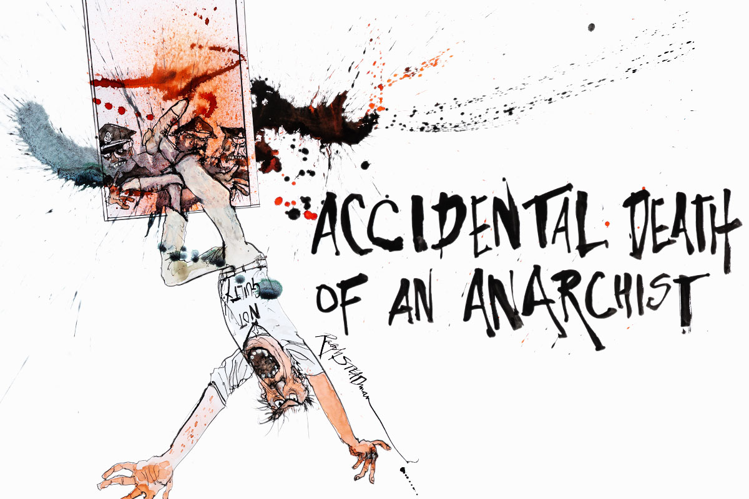
CC – 11
Modern & Contemporary
Drama
I
N
T
R
O
D
U
C
T
I
O
N
D
A
R
I
A
F
o
Daria Fo
of
Dr. Md Naushad Alam
Assistant Professor
P. G. Dept. of English
MMHAPU

Slide 2
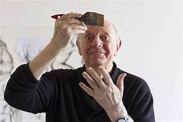
Dario Fo: Introduction
For three decades Dario Fo has been the world's most performed living playwright and Europe's leading radical dramatist. He was awarded the 1997 Nobel Prize for Literature at the age of 71 for his contributions as a writer, actor and mime artist over half a century.
He is an Italian avant-garde playwright, manager-director, actor-mime, comedian, singer, theatre director, stage designer songwriter, painter, political campaigner.
He often faced government censure as a theatrical caricaturist with a flair for social agitation.
His dramatic work depends on improvisation and comprises the recovery of "illegitimate" forms of theatre.
His work of the 1960s, 1970s and 1980s is peppered with criticisms of assassinations, corruption, organised crime, racism, Roman Catholic theology and war..
March 24, 1926 - October 13, 2016

Slide 3
Dario Fo and his wife, the actress France Rame, produced (1962) humorous sketches on the television show Canzonissima that soon made them popular public personalities.
They founded the theatre companies:
Campagnia Dario Fo–Franca Rame (1958)
Nuova Scena (1968), and
Collettivo Teatrale La Comune (1970)
Fo wrote more than 80 plays, co-authoring some of them with Rame.
Among his most popular plays are:
Accidental Death of an Anarchist (1970), and We Can’t Pay? We Won’t Pay! (1974).
As a performer, Fo is best known for his solo tour de force “Comic Mystery” (1973), based on medieval mystery plays but so topical that the shows changed with each audience.

Slide 4
His later works, some of which were written with Rame, include
All House, Bed, and Church” (1978)
Trumpets and Raspberries (1981)
Female Parts (1981)
The Open Couple—Wide Open Even (1983)
One Was Nude and One Wore Tails (1985)
The Pope and the Witch (1989)
Johan Padan and the Discovery of the Americas (1992)
The Devil with Boobs (1998), Francis, the Holy Jester (1999), and
The Two-Headed Anomaly (2003)
In addition, Fo wrote two illustrated novels “The Pope’s Daughter” (2014) and “There Is a Mad King in Denmark” (2015). The former was adapted as a stage play.
PAGE 4
PAGE 4

Slide 5
Filmography:
***Wiki
Year | Title | Role | Notes
1955 | Scuola elementare | Typographer
1956 | Lo svitato | Achille
1957 | Souvenir d'Italie | Carlino | Uncredited
1957 | Rascel-Fifì | Pupo - il biondo
1958 | Nata di marzo | Cantante in osteria | Uncredited
1958 | Domenica è sempre domenica | The Silk Stockings Salesman
1963 | Follie d'estate | Gangster
1989 | Musica per vecchi animali | Lucio Lucertola
1996 | La freccia azzurra | Scarafoni | Voice
2002 | Johan Padan a la descoverta de le Americhe | Johan Padan (veccho) | Voice
2016 | Sweet Democracy |  | (final film role)
2016 | La fantastica storia di Marc Chagall | Himself
2017 | Dario Fo e Franca Rame, la nostra storia | Himself
PAGE 5

Slide 6
Awards and Honours
1981 : Sonning Prize from Copenhagen University
1985 : Premio Eduardo Award
1986 : Obie Award in New York (with Franca Rame)
1987 : Agro Dolce Prize
Year unknown : Honorary doctorate from the Vrije Universiteit Brussel, Belgium
1997 : Nobel Prize in Literature
..the end.
PAGE 6

